Slide 1

SONG RECOMMENDER USING FACIAL EXPRESSION
Internal Guide: DR.B.ANKAYARKANNI
Name of the Student: Mr. HARIHARAN B P
Register Number: 39110373

Slide 2
Presentation Outline
Project
Introduction
Objectives
Ideation Map
Module Implementation
Methodology
Design Principles
Application Snapshots
Results and Discussions
Conclusion & Future work
References

Slide 3
Project
As we have taken option 1(THE PRIDE), and we are a team of 3 members,
JAGADEESH. N (39110393)
MOHNISH DEVARAJ (39110636)
HARIHARAN B P (39110373)
So, we have taken our own project and we are working under the guidance of Dr. Albert J Mayan M.E., Ph.D.,
We have taken this as our final project as this is a big and new app for the android platforms.

Slide 4
MODULES:
Module-1: Emotion Detection (Completed).
Module-2: App frontend UI with Cloud integration.
Module-3: Merging the front-end with the Emotion Detection Model.

Slide 5
Introduction
“SONG RECOMMEDER SYSTEM USING EMOTION EXPRESSION” is an Android Application where a user will be able to play songs according to their mood(emotion).
This application lets the user to select the language and using emotional recognition.
“SONG” a well-known and very meaningful word, which is the one-stop you will go to calm your mind and all the surroundings will be gone when you dive into this virtual world full of your favorite songs.
Music plays an important role in an individual’s life. It is an important source of entertainment and is often associated with a therapeutic role.
With the Advent of technology and continuous Advancements in multimedia, sophisticated music players have been.
As we all know, human emotion played a vital role in recent times and will play in coming future.
To overcome these scenarios this idea has been developed and also is the objective of this idea.

Slide 6
Objectives
“SONG RECOMMEDER SYSTEM USING EMOTION DETECTION” is an Android Application where a user will be able to play songs according to their mood(emotion). This application lets the user to select the language and using emotional recognition.
The objective of the project is to extract feature from human face and detect emotion and play music according to the emotion detected. Facial expressions are captured locally using a camera device. Then the facial structures are compared and the songs are played based on what the emotion is.
Android is open source code mobile phone operating system that comes out by Google. Music player in this project is application software based on Google Android. Music is one of the best ways to relieve pressure in stressful modern society life. The purpose of this project is to develop a player which can play the mainstream file format. To browse and query the storage space as well as operation of playing can be realised. Meanwhile, this software can play, pause and select songs with latest button and next button according to sets requirement as well as set up songs.

Slide 7
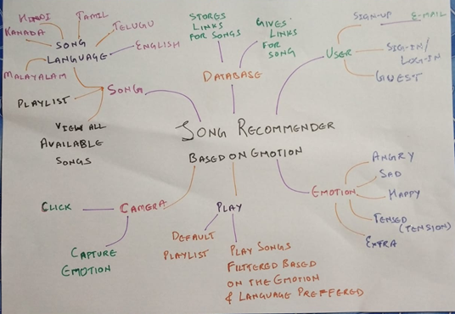
Ideation Map

Slide 8
Project Implementation
ANDRIOD DEVELOPMENT ENVIRONMENT
Install the Android SDK
Android Studio installs the latest Android SDK by default. Building a React Native app with native code, however, requires the Android 11 (R) SDK in particular. Additional Android SDKs can be installed through the SDK Manager in Android Studio.
Config the Android home environment variable
Add platform-tools to path
To start the application:-
1) Turn on the emulator in android studio
2) In your terminal navigate to your project root
3) run the following command:- npx react-native run-android

Slide 9
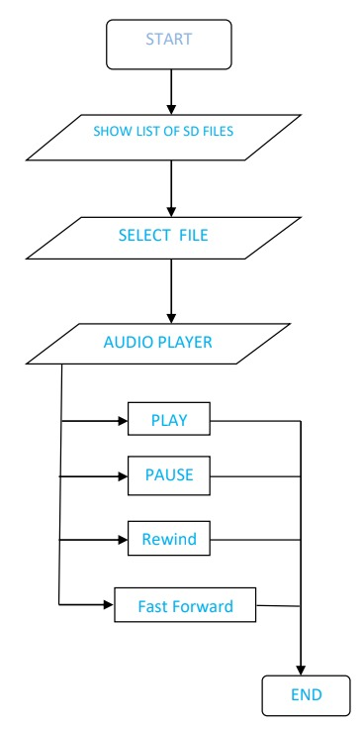
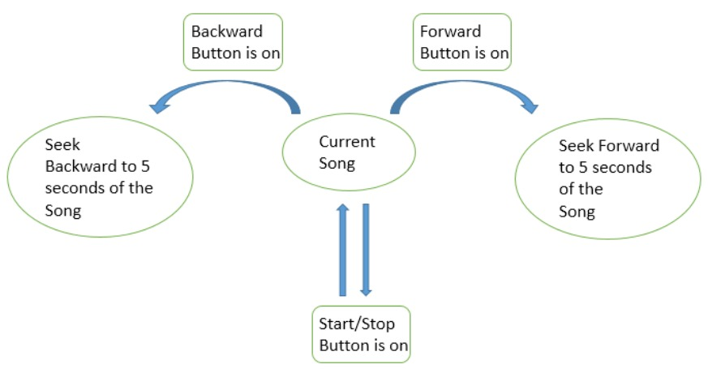
Project Implementation

Slide 10
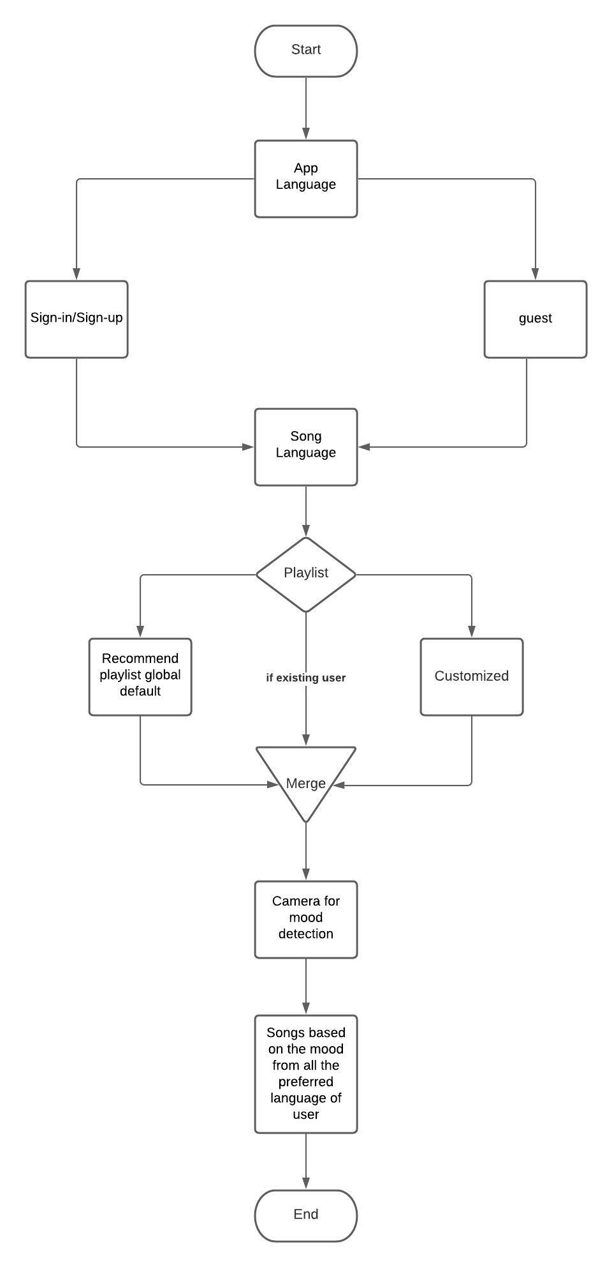
Project Implementation
In this project, the agile development cycle will be used to guide the development process.
The reason for using agile methods is that mobile applications have a short software life cycle and rapidly changing technologies, so users will constantly change their requirement and needs in response to technological changes.

Slide 11
Project Implementation
HARDWARE REQUIREMENTS:
1) Android Device/Emulator
2) Android 8 or more.
3) Min of 4GB RAM in device.
SOFTWARE REQUIREMENTS:
1) VSCode/Android Studio for making any development changes
2) React-Native version 0.68
TOOLS/LANGUAGES USED:
Firebase
Figma
Canva
JavaScript
Functional requirements include song playlist, login/signup functions, song play functions.
Non-functional requirements include usability, scalability, convenience, and others.

Slide 12
Methodology
In this project, the agile development cycle will be used to guide the development process. The reason for using agile methods is that mobile applications have a short software life cycle and rapidly changing technologies, so users will constantly change their requirement and needs in response to technological changes.
Step 1: Open a new android project
Step 2: Designing the User Interface of the app
a imageView– to show our given image for the song3
Buttons : a play button to play our song pause button to pause our song stop button to stop our song
Horizontal Linear Layout
Forward/backward
Step 3: Adding the music file to our app
Step 4: Let’s code the functionality of our App
Step 5: Let’s Run our app

Slide 13
Design Principles
Reliability:
The reliability of the software system refers to the ability to avoid fault occurred in the process of system running, as well as the ability to remedy troubles once the fault occurs.
(2) Reusability:
Look for commonness of similar codes, and come out new method abstractly and reasonably
(3) Understandability:
The understandability of software not only require clear and readable document, but the simplified structure of software itself
(4) Simple program:
To keep the program simple and clear, good programmers can use simple program to solve complex problems.
(5) Testability:
Testability means that the created system has a proper data collection to conduct a comprehensive test of the entire system

Slide 14
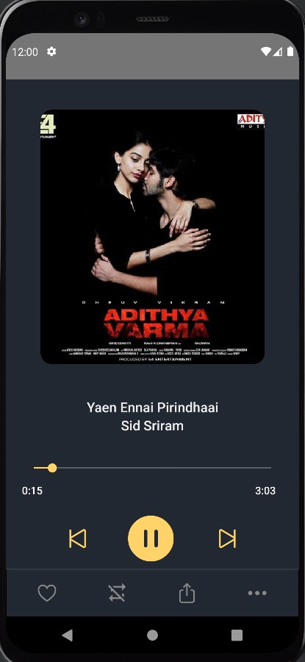
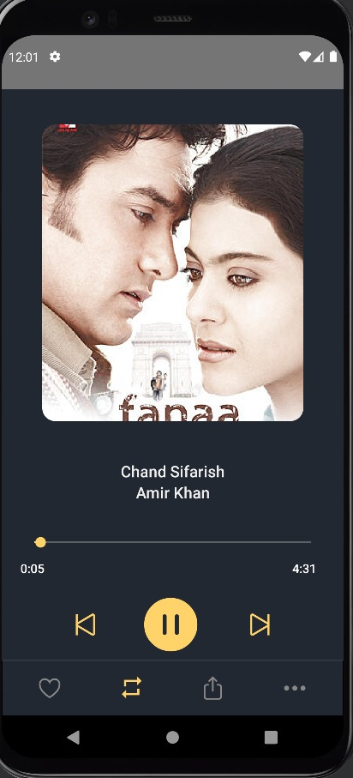
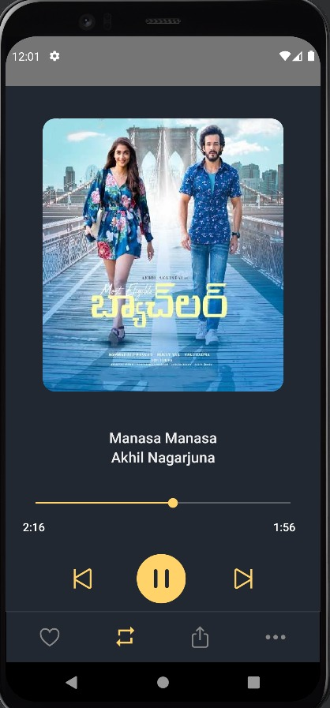
Application Screen shots

Slide 15
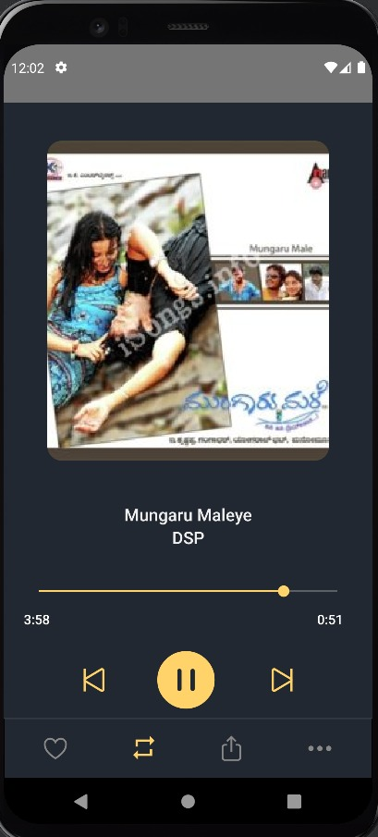
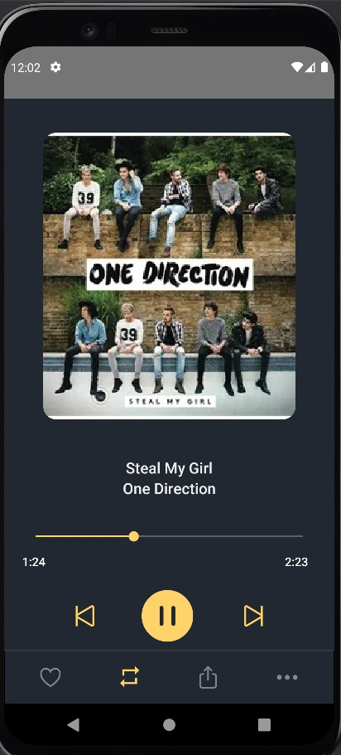
Application Screen shots

Slide 16
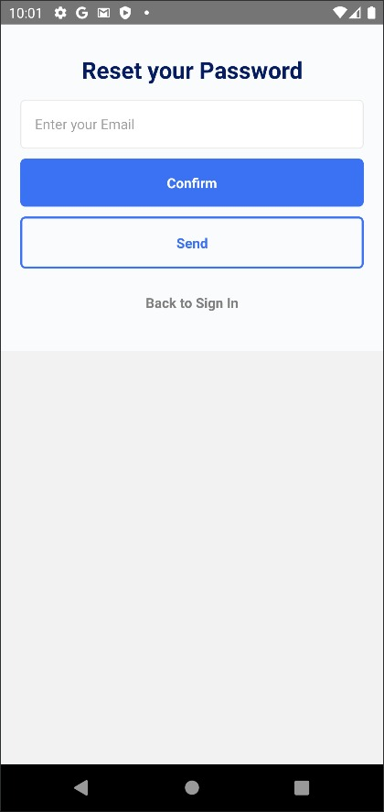
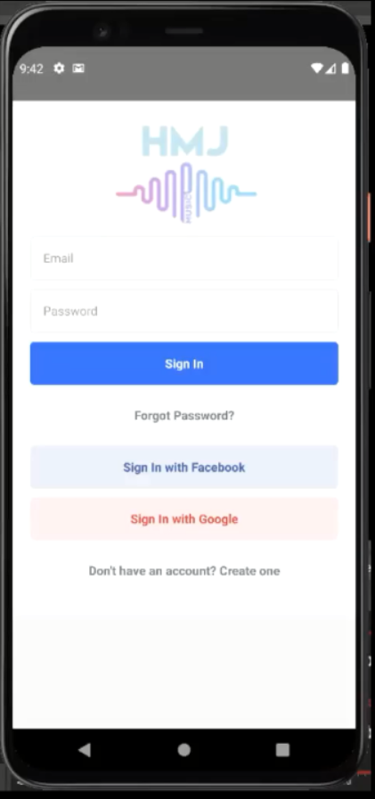

Slide 17
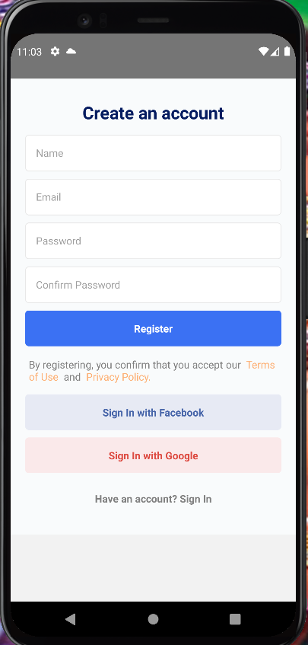
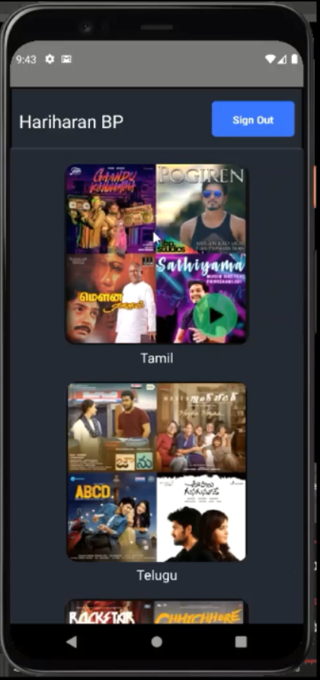

Slide 18
Results and Discussion
This project has been developed to give us great advancement in the field of machine learning technology.
Emotion Based Music player fulfils to sort out the music based on the emotions of the user such as whether it is happy or sad.
So, totally our work aims to develop a player which is based on user need and it helps to revive in case of free time or leisure time if we want to hear music based on our current situation.
UI has been implemented to integrate with the deep learning model

Slide 19
Results and Discussion
FUTURE WORKS:
I. Enhanced interactivity, allowing users to open song playlist when they swipe up from the music playing interface
Implement of the in-app download of songs, rather than the current use of aspecific website as a hyperlink
Refactoring code, rebuild the coding structure to make the coding look cleaner,easier to understand and perform efficiently
Cross-platform, running the app on IOS, not only Android

Slide 20
Conclusion
This project has been developed to give us great advancement in the field of machine learning technology.
Emotion Based Music player fulfils to sort out the music based on the emotions of the user such as whether it is happy or sad.
So, totally our work aims to develop a player which is based on user need and it helps to revive in case of free time or leisure time if we want to hear music based on our current situation.
Music player system realized the basic function of player: play, pause, rewind and fast forward a, volume adjustment is performed through the Android System Itself, play mode, seek bar, This development implicated the popular mobile terminal development technology
It is a basic and simple music player and can be use hassle free, with simple controls and functions.

Slide 21
References
[1] Spotify — Song Prediction and Recommendation System by : Sunku Sowmya Sree Source: https://medium.com/swlh/spotify-song-prediction-and-recommendation-system-b3bbc71398ad
[2] Create Music Recommendation System Using Python by : Ajinkya Khobragade Source: https://towardsdatascience.com/create-music-recommendation-system-using-python-ce5401317159
[3] Facial Recognition using OpenCV
by: Atul Balaji
Source: https://github.com/atulapra/Emotion-detection
[4] A Complete Guide to Adam and RMSprop Optimizer
By: Sanghvirajit
Source: https://medium.com/analytics-vidhya/a-complete-guide-to-adam-and-rmsprop-optimizer-75f4502d83be
[5] Creating an Audio Player in React-Native
By: Bharat Tiwari
Source: https://medium.com/@bharat.tiwari/creating-an-audio-player-in-react-native-2628c4262db4

Slide 22


